Slide 1
SOIL
the foundation for life on Earth!
Notes:
Good morning! I am going to get things kicked off this morning by discussing some general soil information.

Slide 2
What is Soil?
Soil is a natural, three dimensional body at the Earth’s surface capable of supporting plants. Soil is a mixture of:
mineral particles (sand, silt, and clay)
organic materials (living and dead)
water
air
Notes:
Let’s start with a basic definition of soil. It is made up of 4 components:

Slide 3
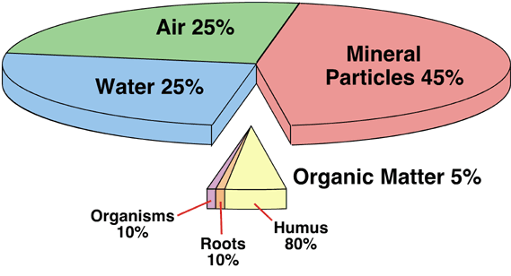
* The values given above are for an average agricultural soil.
Notes:
An “average” agricultural soil contains about 45 percent mineral particles, 5% organic, 25% air, and 25% water. The area where the bulk of the air and water resides is called the pore space. It is difficult to change the mineral side of the pie chart unless there is severe erosion or deposition. It is critical to know how much sand, silt, and clay is in a given soil because the texture plays a large role in many soil interpretations (how the soil will behave under certain uses). The pore space and the organic fractions can be easily changed by management and changes in weather. Compaction has reduced the volume of pore space in many soils and we have lost more than half of our soil organic matter on our agricultural soils across the country.

Slide 4
Soil (continued)
Soil is a living, dynamic natural resource. When healthy, it contains a balance of trillions of living organisms (mostly microbial). These organisms:
improve soil structure/aggregate stability
decompose organic materials
cycle nutrients
make more stable forms of soil organic matter
Notes:
Soil is so much more than dirt- it is a living, dynamic ecosystem. These organisms (especially myccorhyzal fungi) secrete enzymes that glue soil particles together and build soil aggregates. There are more organisms in a tablespoon of healthy topsoil then there are people on the planet!

Slide 5
Soil (continued)
Over 750 different soil types (series) in South Dakota
Many different properties are used to separate soils (texture, color, soil depth, depth to carbonates, mineralogy, climate, internal drainage, clay movement, SAR, EC - to name a few)
Houdek - South Dakota’s State Soil (1990)
Notes:
In SD, we have over 750 different soil types what we refer as soil series. There are many properties we use to separate soil types including: and the list goes on. Back in 1990, the legislature enacted Houdek as the official state soil.

Slide 6
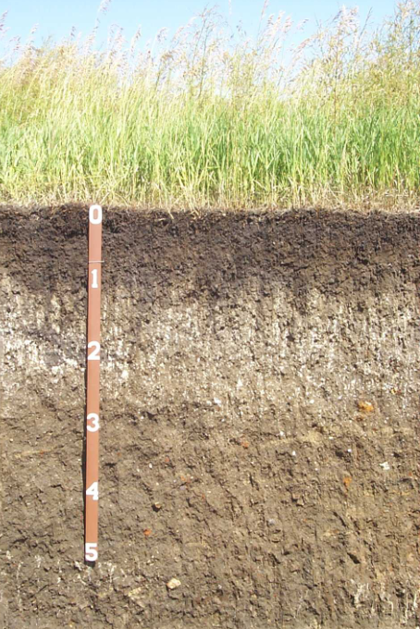
Houdek
ft.
Notes:
Here is a picture of our state soil and I will discuss this soil in a little more detail later on in the presentation.

Slide 7
Why is soil important?
Almost everything comes directly or indirectly from the soil.
the food we eat
the clothes we wear
the shelter we live in
the vehicles we drive
Notes:
So why should we even care about soil? When you think about it, soil is as important as air and water – we couldn’t survive on this planet without it.

Slide 8
Importance of soil (continued)
Soil also plays a critical role in:
Carbon and nitrogen cycles
Storing water for plant use (water cycle)
Filtering surface waters
Disposal of solid and liquid wastes
Supporting our buildings and roads
Notes:
There are so many functions our soils provide including playing a major role in:

Slide 9
Soil Genesis
Notes:
So, where does soil come from? Has it been here since the dawn of time?

Slide 10
How is soil formed?
Soil develops as a result of five primary soil forming factors acting together.
Climate
Parent Material
Biotic Factors
Topography
Time
Notes:
Soil develops as a result of 5 soil forming factors acting together. You have to consider all factors when determining the genesis of a given soil. Biotic factors are very important and we are learning more and more about just how important soil microorganisms are especially when it comes to the health of our soils.

Slide 11
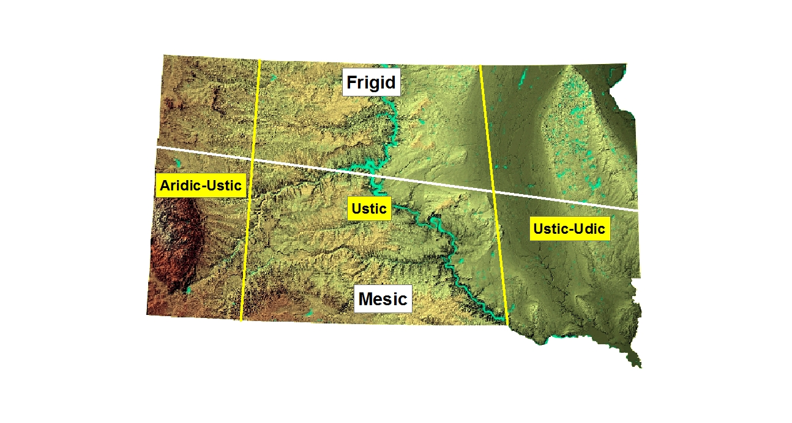
Soil Temperature and Moisture Regimes (example taxonomic classification Opal soil: Fine, smectitic, mesic Leptic Haplustert)
Notes:
Climate is significant especially in terms of it’s long term affect on vegetation and transformations and translocations within soil. This picture shows some very broad soil temperature and moisture regimes in SD – in the real world, these are not straight lines. The white line (excluding the Black Hills) separates cooler vs warmer temperature regimes. The yellow lines distinguish moisture regimes. This information can be found in the taxonomic classification of the soils. Cooler/drier in the NW, warmer/drier in the SW, etc. (>precip=>transformations/translocations + biomass production).

Slide 12
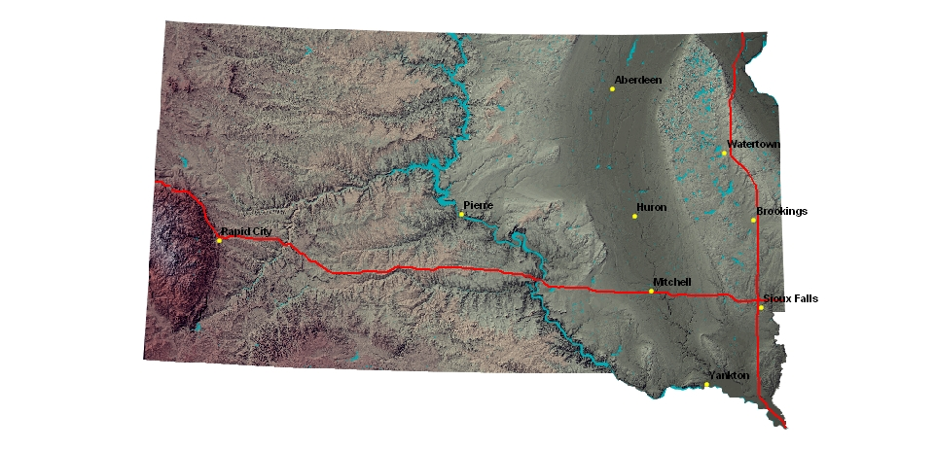
South Dakota Shaded Relief Map
Notes:
The next factor I want to talk about is parent material or the geology. The parent material plays a huge role in what a soil looks and feels like. Looking at this image, the biggest thing that sticks out is how much smoother it looks in the eastern part of the state. What happened in the eastern part of the state that didn’t happen in the west? Of course this is due to glaciation in the east part of the state. This also played a significant role in time soil forming factor that I will talk about in a bit.

Slide 13
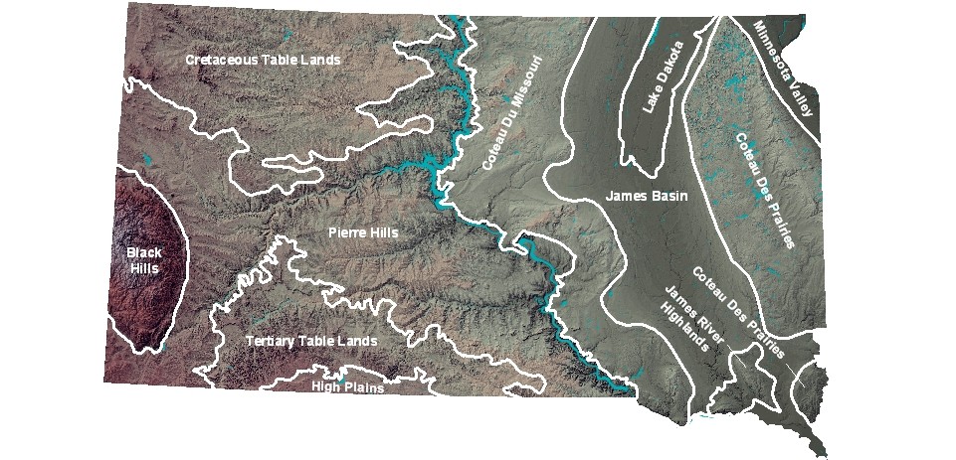
South Dakota Physiographic Areas
Notes:
Taking a little closer look, I have identified the broad physiographic boundaries in the state. I’m a little biased but the geology out east is pretty boring so let’s discuss the west. Outside the Black Hills over a third of western SD is in the Pierre Hills. The Pierre shale has a high clay content so naturally the soils derived from it have a high clay content which has a significant impact on land use decisions especially engineering practices.

Slide 14
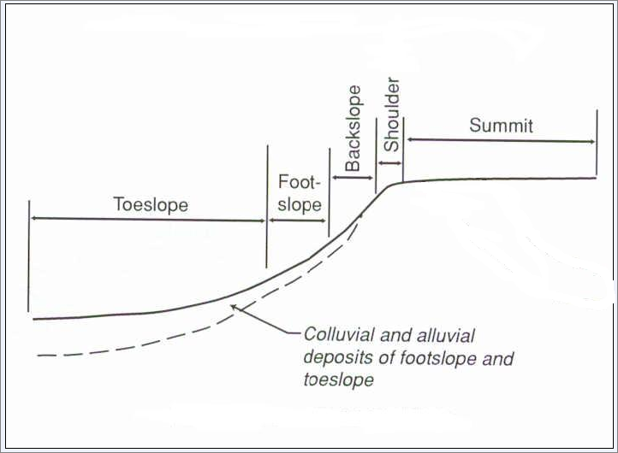
Hillslope Positions
Notes:
Topography plays a large role in the depth and development of our soils due to the stability of the different hillslope positions. A flat summit is the most stable position. The shoulder is most erosive – normally the steepest part of the landscape. Footslopes/toeslopes normally have deep or very deep soil profiles. What do I mean by deep and very deep profiles?

Slide 15
ESTIMATING SLOPE
5 percent slope
2 feet
3 feet
3 feet
Straight edge at eye level
Slope stakes are 100 feet apart
Notes:
In this example it takes 1 and 2/3rds (or 5 feet) slope stakes to reach the base of the upper slope stake, thus the slope at 100’ is 5 percent. Remember to double the slope percent (i.e., 10%) if the slope stakes are 50 feet apart.

Slide 16
Soil Depth Classes (Depth to bedrock):
Very Deep - 60+ inches (150+ cm.)
Deep – 40 to 60 in. (100 – 150 cm.)
Moderately Deep – 20 to 40 inches (50 – 100 cm.)
Shallow – 10 to 20 inches (25 – 50 cm.)
Very Shallow - < 10 inches (< 25 cm.)
Notes:
In soil survey, we have 5 soil depth classes which are based on depth to bedrock (soft or hard). As a general rule, the deeper soils are more productive and the shallow soils are far less productive..

Slide 17
Soil and Root Restrictive Layers
Bedrock (both hard and soft)
Sand and gravel
Claypan (natric horizon)
Water table
Compaction
Notes:
Here is a list of the most common restrictive layers found in our state. They include:

Slide 18
Soil Restrictive Layers
Influences:
Rooting depth
Water infiltration and permeability
Salt accumulation
Land use and management
Water holding capacity
Notes:
The influences of restrictive layers are pretty straight forward but the water holding capacity has probably the single most significant effect in terms of plant communities and growth that most people really don’t think about. Naturally, the less water holding capacity the less production and plant communities normally are reflected by short, more drought tolerant species. Any questions on restrictive layers?

Slide 19
How long does it take for soil to form?
In South Dakota, soils have been forming for thousands (east river) to millions of years (west river).
In SD, it takes hundreds (200 to 500) of years to form one inch of topsoil - depending on the 5 soil forming factors.
Notes:
Time is a trickier soil forming factor to discern because you would think the longer a soil has been stable the more soil formation will have occurred. One monkey wrench to this theory is glaciation. Our eastern SD soils generally are more developed because the glaciers put the weathering of bedrocks on steroids. This is why we look at all 5 soil forming factors to evaluate the genesis of a given soil.

Slide 20
Soil Morphology
Notes:
I am not going to bore you with a lot of soil taxonomy (remember that example given for climate) but there are a few things I need to discuss.

Slide 21
Master Horizons:
(A, B, C) others: O, E, and R
Suffixes:
p – denotes plow layer
t – denotes an accumulation of clay
k – denotes an accumulation of calcium carbonate
Ap
Topsoil
Bt
Argillic
Bk
Subsoil
Calcic
C
Parent Material (Glacial Till)
ft.
Houdek
Notes:
As we look at our state soil again and I have added the layering that is present. This is in part what soil scientists do to separate and classify different soils. We break down these broad layers into master horizons and add suffixes to those to denote soil forming processes that have taken place. At one point in time, everything looked like C horizon. Why is it darker colored in the surface? This same soil under cultivation typically has half the amount of organic matter.

Slide 22
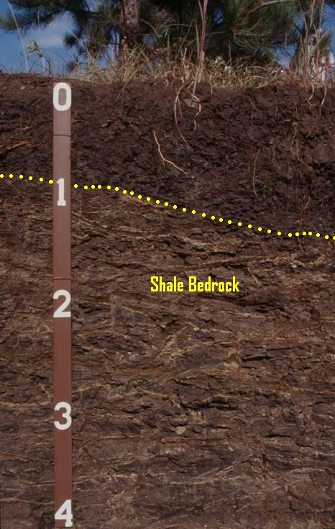
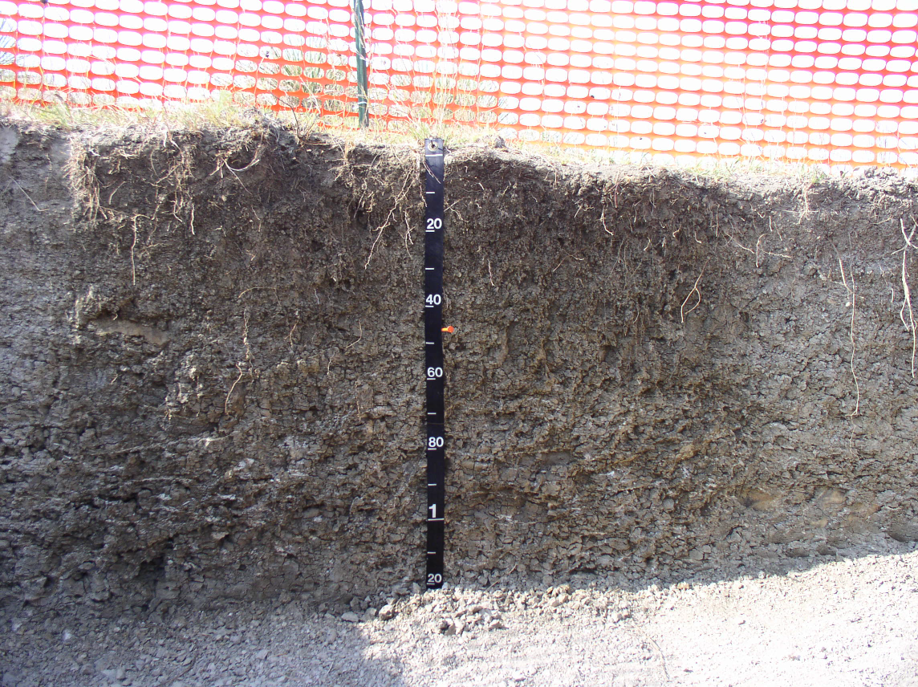
Grummit Soil
Samsil Soil
cm.
cm..
ft.
cm.
Shale Bedrock - 45 cm. (18 in.)
Notes:
As I mentioned before we have over 750 different soil types in SD. I’ll show a few of the more common soils in our area just to show some contrast we have in our soils – dirt isn’t just dirt..

Slide 23
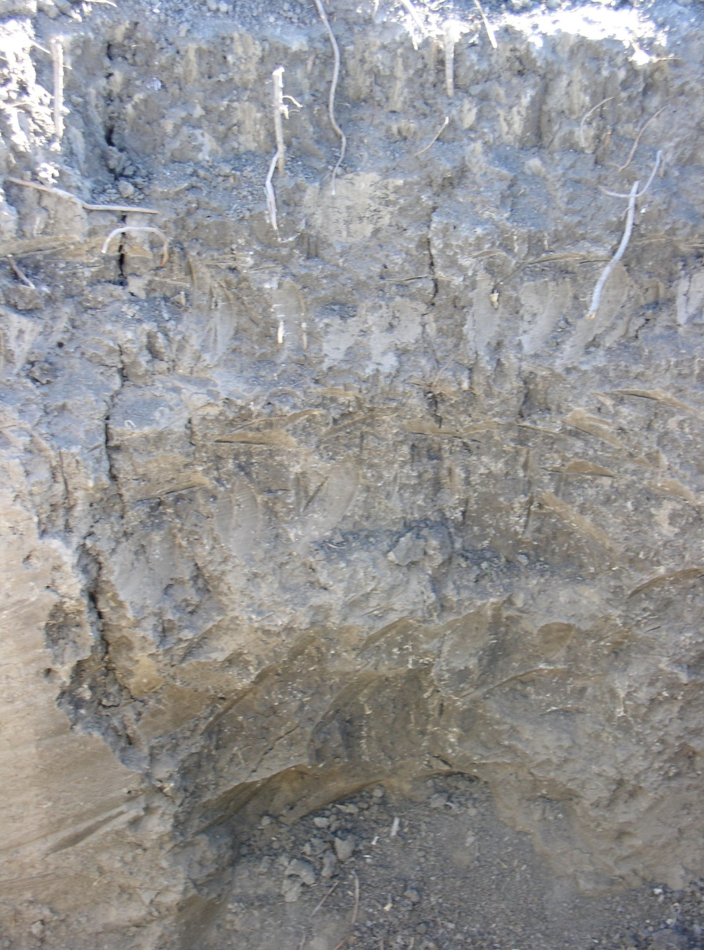
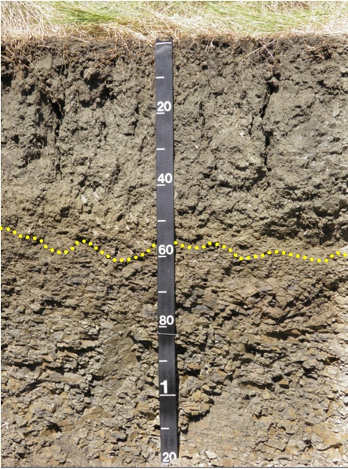
Kyle Soil
Pierre Soil
cm.
Visible salts -17”
EC – 6.5 dS/m
AWC – 6”/60”
Shale – 45 cm.
Clay - 51% ave.
Shale
Bedrock
Notes:
The salts in this soil are much higher than what is typical for the Kyle soil due to irrigation with sub-par water.

Slide 24
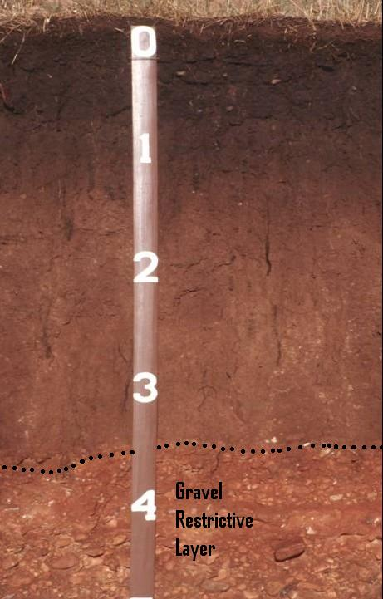
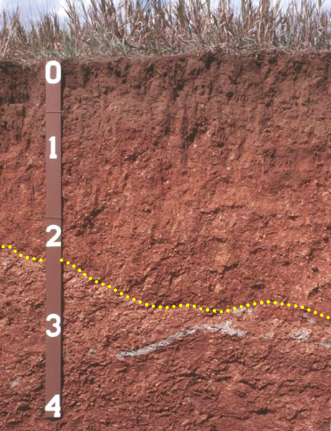
ft.
Tilford Soil
ft.
Gypnevee Soil
Bedrock w/ Gypsum
Notes:
These soils are found in the Redbeds which ring the outside of the Black Hills. These soils formed in the Spearfish formation - High iron deposit during the Jurassic time.

Slide 25
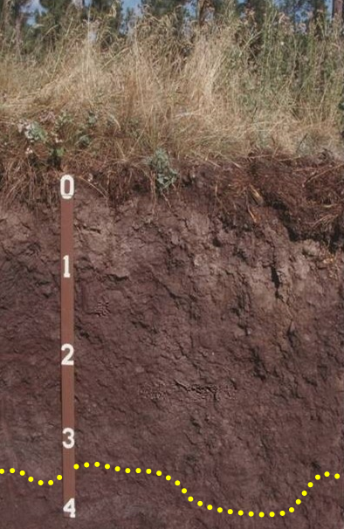
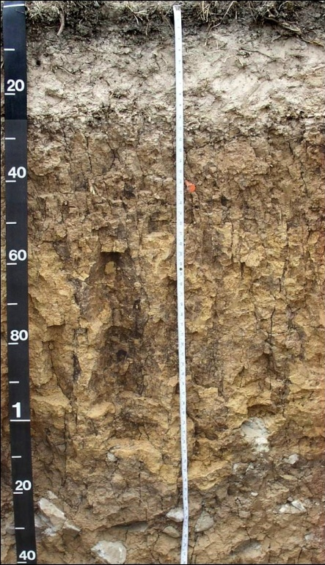
cm.
Buska Soil
Citadel Soil
ft.
Parent Material Micaceous Schist
Limestone
Rock Fragments
Bedrock
Notes:
These soils are found in the Black Hills. Look at how much different in appearance these soils are due to the forested environment. O and E horizons.

Slide 26
What does soil feel like?
The feel of soil varies primarily on it’s texture (amount of sand, silt, and clay).
4 Broad Groups:
Sandy – gritty, loose, unstable, droughty
Silty – smooth, soft, low strength
Clayey – sticky when wet, hard, high strength
Loamy – combination of the 3 above in about equal amounts
Notes:
Our clayey soils are comprised of smectitic clays which expand and contract during wetting and drying cycles and are very sticky when wet – Gumbo. Which group has a higher potential for compaction?

Slide 27
Soil Texture
Definition (USDA ) - the weight proportion of the soil separates less than 2.0 mm in size (sand, silt, and clay). Or, more commonly, the relative proportions of sand, silt, and clay
Sand = 2.0 to 0.05mm
Silt = 0.05 to 0.002mm
Clay = < 0.002mm
Sand, silt, and clay in various proportions make up 12 textural classes
Notes:
The texture of soil is the relative proportions of sand, silt, and clay. The sizes are listed for each but simply put, you can see sand and coarse silt with the naked eye. Need an electron microscope to see clay sized particles.

Slide 28
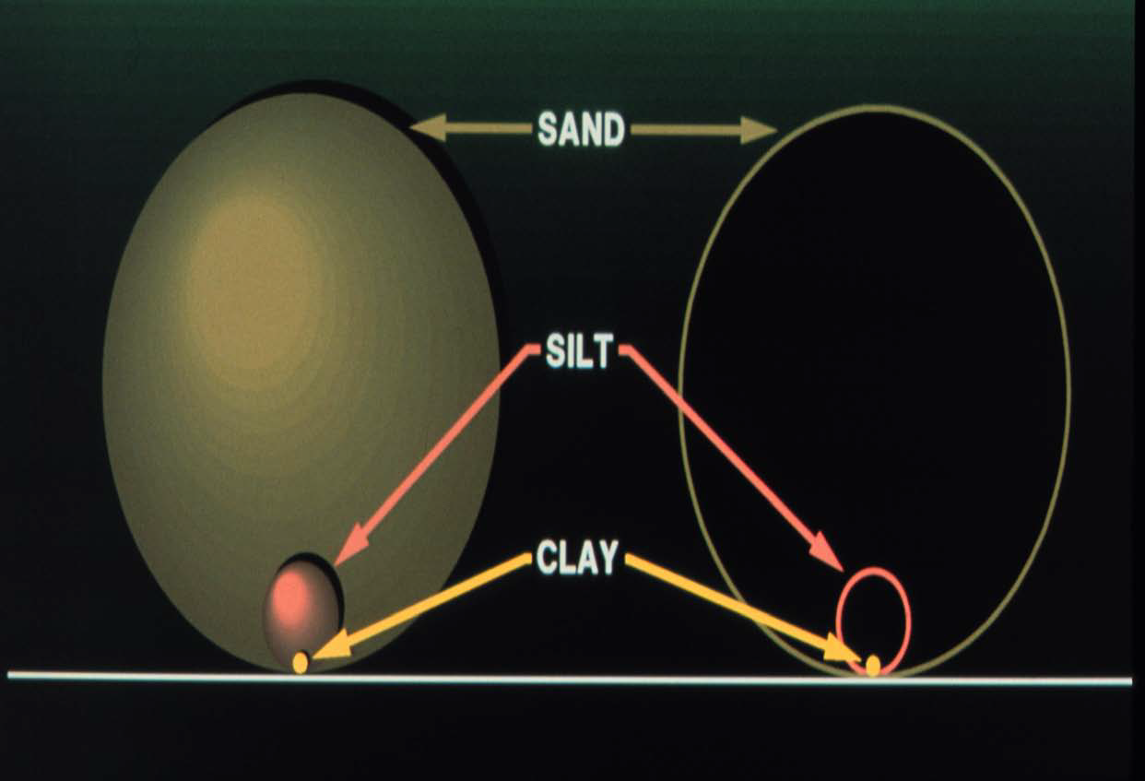
Notes:
This slide shows the relative size of each particle size. Another way to demonstrate the relative sizes is by using a basketball, tennis ball, and needle head.

Slide 29
Textural Triangle
In the field, soil scientists use the ribbon method to determine soil texture. Need to estimate the amount of 2 particles – normally clay and sand contents.
Samples are also collected to run particle size analysis in the lab. Two methods are used:
- Hydrometer Method
Pipette Method (more accurate - +- 3%)
What texture is: 40% sand, 20% clay?
Notes:
We refine the texture to meet our soil survey standards and use primarily 2 methods - mostly use the field method but do send samples in for lab analysis on occasion. We apply those measurements to come up with a soil texture for each layer.

Slide 30
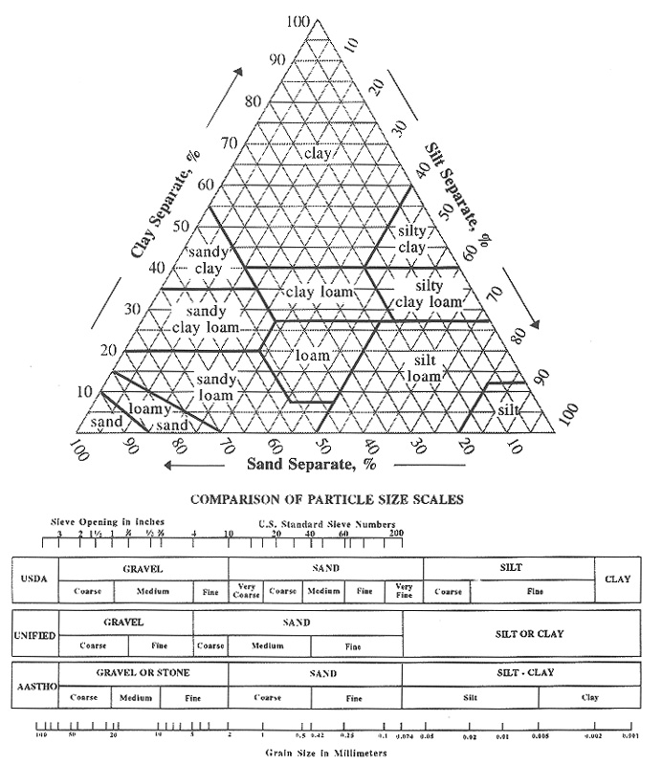
USDA Textural Triangle
Clay < .002 mm
Textural Class
The percentage of sand sized particles + % of silt sized particles + % of clay sized particles (all combined = 100%)
Example:
35 % sand
55 % silt
10 % clay
Texture is ‘silt loam’
Sand 0.05 - 2.0 mm
Silt 0.002 to .05 mm
Notes:
We use the textural triangle to identify texture classes. Here is an example of how to use the Textural Triangle. So how many particles do you need to figure out? 2 – usually clay and sand. Provide another example and have the audience determine the texture (45% clay, 40% sand, and 15% silt = clay).

Slide 31
Coarse Fragments
Mineral particles larger than 2.0 mm = rock fragments (gravels, channers, stones, cobbles, boulders, or flagstones) + para modifiers (not strongly cemented – i.e. parachanners)
Texture Modifiers:
< 15% - no texture modifier
15 - 35% - gravelly, channery, stony, bouldery, flaggy
35 - 60% - very gravelly, very channery, etc.
60 - 90% - extremely gravelly, extremely channery, etc.
> 90% - no texture just modifier (i.e. gravel)
Notes:
Soil texture is made up of a “textural class” and any “modifier” that is appropriate. The total of the mineral soil particles less than 2 mm are collectively referred to as the “fine earth fraction”. This fine earth fraction is what we use to determine the textural class. The mineral soil particles greater than 2 mm are referred to as coarse fragments and they include gravels, channers, stones, cobbles, boulders, and flagstones. If present and greater than 15 percent, these modifiers are added to the textural class. So if we had a loam horizon with 25 percent gravel in it, the texture class would be gravelly loam. If greater than 90 percent, just the modifier is used.

Slide 32
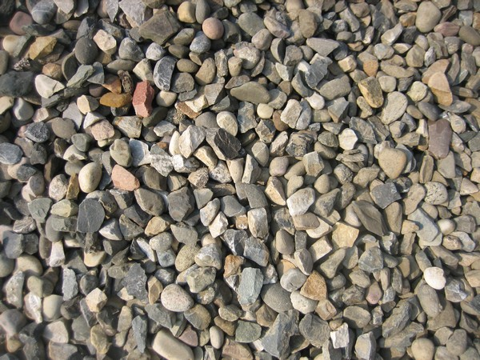
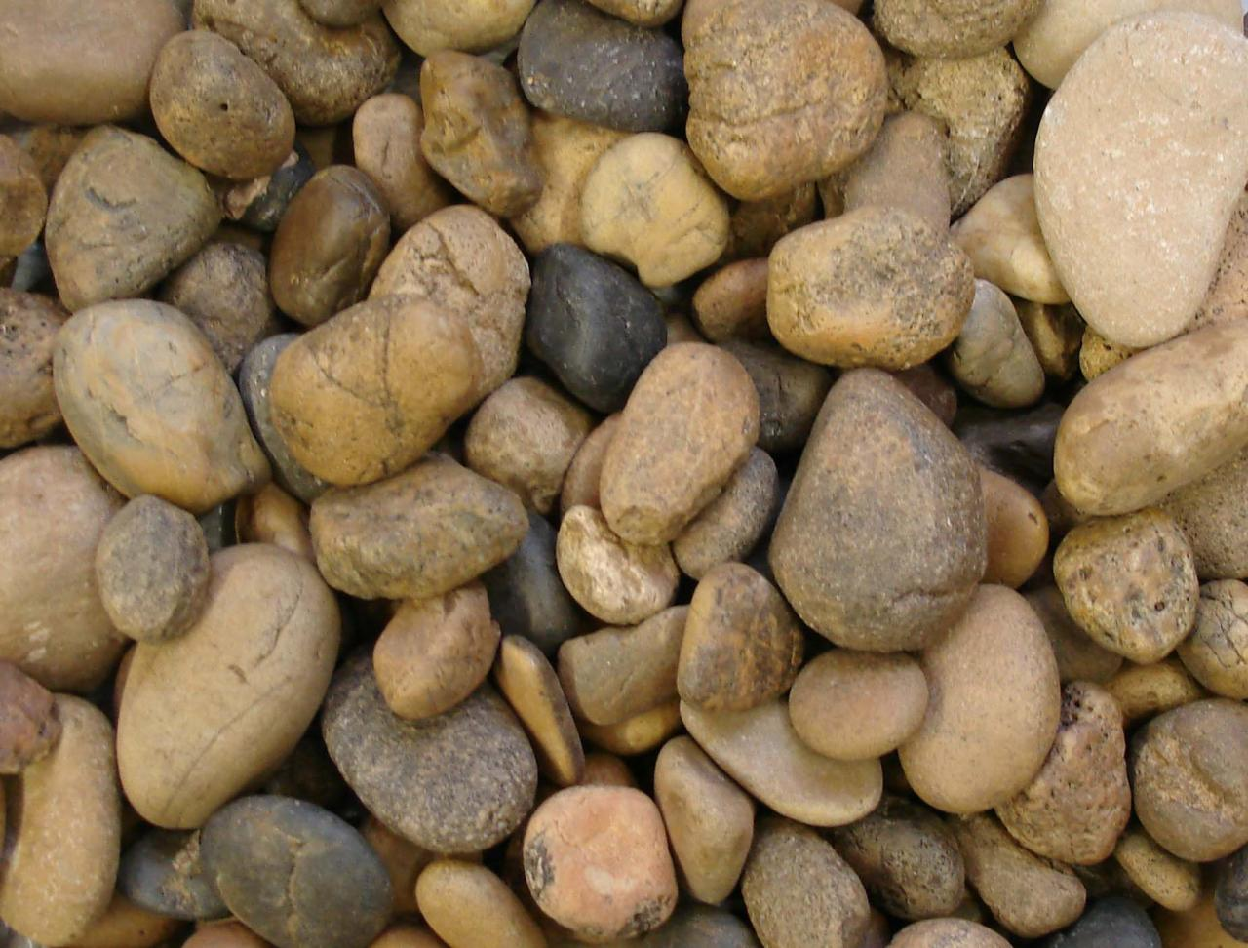
Coarse Fragments
Gravels: 2.0 to 75 mm (.08 to 3 in.)
Cobbles: 76 to 250 mm
(3 – 10 in.)
Notes:
The next few slides show pictures of the different coarse fragments.

Slide 33
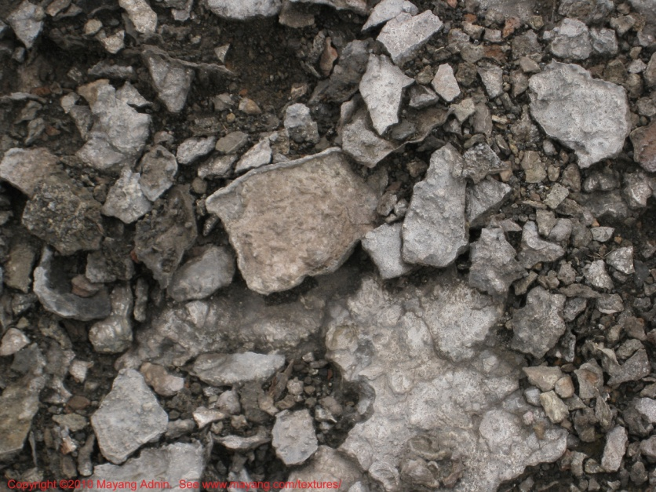
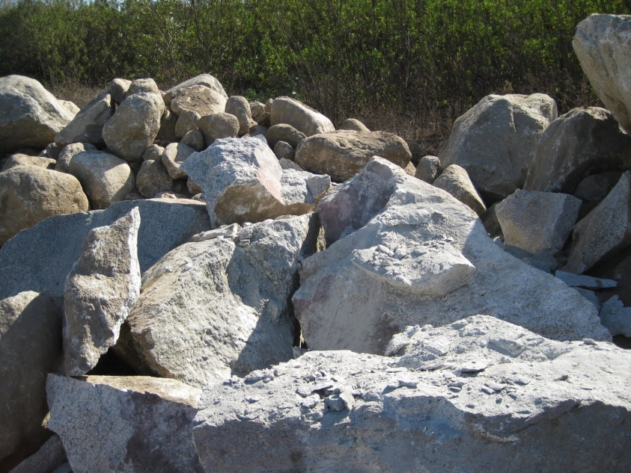
Coarse Fragments
Stones: 250 to 600mm
(10 – 24 in.)
Boulders: 600mm+
(>24 in)

Slide 34
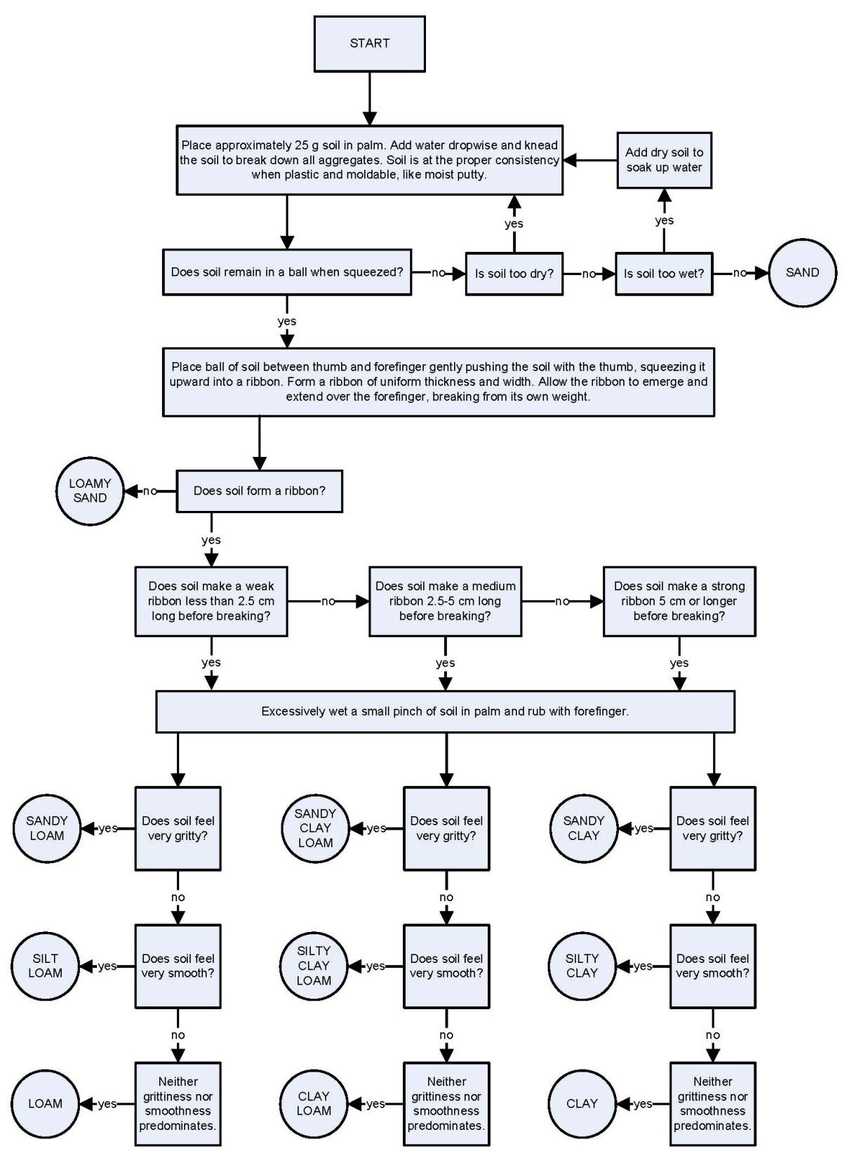
TEXTURAL CLASSES BY “FEEL” METHOD
Notes:
We determine soil texture by feel – the ribbon method in the field and this chart kind of walks you through the process. It takes a lot of practice with samples of known amounts of sand, silt, and clay to get good at it. Demonstrate soil texturing!

Slide 35
Soil Structure
The aggregation of primary particles into secondary units surrounded by planes of weakness.
Factors:
Wetting and drying
Freezing and thawing
Root action
Animal/microbial activity
Organic matter
Clay minerology
Granular
Blocky
Platy
Prismatic
Columnar
Massive
Initial material
Pores
Ped face
Porosity 30 to 60 % of ped volume depending on texture
Notes:
Soil structure is a result of the aggregation of sand, silt, and clay into secondary units which are surrounded by planes of weakness. All these factors affect the parent material to build soil structure. Structure can be altered by man especially in the upper parts of the soil profile primarily through tillage and compaction.
Structure creates porosity for water and air movement and also provides additional surfaces for chemical and physical processes. A ped is an individual soil structural unit.

Slide 36
Soil Structure - Shapes
Granular - peds are approximately spherical or polyhedral and are bounded by curved or irregular faces (A horizons)
Platy - the peds are flat and “platelike” (think of a stack of dinner plates); usually oriented horizontally - E horizons
Blocky - somewhat “blocklike”; bounded by flat or slightly rounded surfaces; nearly equidimensional (Upper B horizons)
Prismatic - peds are longer than they are wide (Lower B horizons)
Columnar – similar to prismatic but has rounded tops often referred to as biscuit tops (B horizons)
Single grain – no structural units; entirely noncoherent; example is loose sand
Notes:
Here is a list of soil structure shapes. Granular structure is like cottage cheese (read above). Compacted layers are not platy or any other structure. It is structureless!

Slide 37
Why is it important to protect soil?
Soil is a limited resource!
soil takes hundreds of years to form
losing topsoil can quickly degrade the soil’s productivity and ability to grow crops or raise livestock
poor management can result in significant losses of topsoil (erosion – both wind and water) in a short period of time (hours/days)
Notes:
Why should we be concerned about protecting and regenerating our soils? Remember, it’s in the topsoil where the bulk of the microbial activity happens including cycling of nutrients. Will have to rely even more heavily on synthetics.

Slide 38
What can I do to protect/improve soil?
Soil is most productive when kept healthy and in place. There are 5 Principles to Achieving Soil Health:
Keep soil covered at all times (residue)
Minimal or no soil disturbance (eliminate tillage)
Increase plant diversity (rotations and cover crops)
Keep a living root in soil as long as possible (use of cover crops, winter annuals)
Incorporate livestock into cropping systems
Notes:
Need to have a concerted effort to apply all 5 principles if possible but the first 3 are essential. Keeping the soil armored at all times is critical in our area because we have a high potential for wind erosion in many of our soils.

Slide 39
Organic matter (carbon) is essential to soil health and helps maintain/improve:
microbial populations
aggregate stability/soil structure
water infiltration and storage
nutrient cycling
sustainability
Pow
Notes:
As we look at the principles of soil health, it all boils down to carbon! If you are doing things that are building soil organic matter then you are well on your way to improving the health of your soil.

Slide 40
Salinity vs Sodicity
Salinity - refers to content of salts in the soil profile. Measured with an electrical conductivity (EC) meter.
Sodicity - refers to the content of sodium in the soil profile. Measured in the lab as SAR or ESP.
Saline/sodic- has both salinity and sodicity issues. Not very common in the natural world but has been influenced by man through management especially in eastern SD.
Notes:
Finally, lets briefly talk about salinity and sodicity. They are completely different but are often incorrectly described interchangeably. (read above)

Slide 41
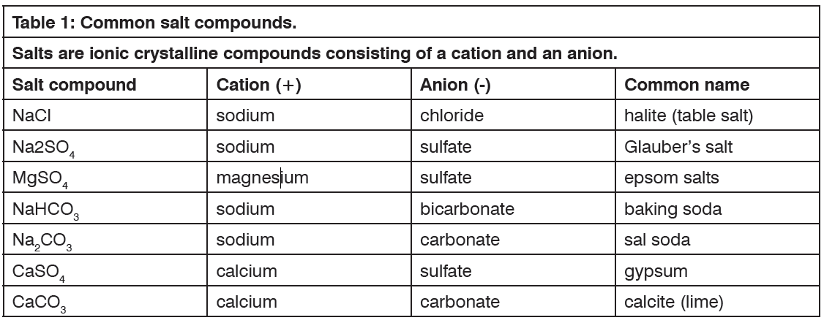
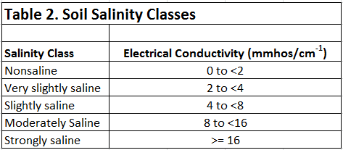
Notes:
Table 1 shows the common salt compounds in soils and of these, gypsum, calcite, and epsom are the most common salts we see in this area. CaCO3 is a salt but it is not normally what we find in our saline soils – it is gypsum or epsom salts. Why would you apply gypsum or even lime to try and reclaim saline areas?
Table 2 shows the salinity classes we use in soil survey. In order for a soil to be classified as saline, the soil must have an Electrical Conductivity of at least 4 but can start seeing affects of salinity on soils with an EC of 2 depending on crop.

Slide 42
Land Capability Classes
The capability class (often shown as a Roman numeral; e.g. VI) tells you how limited the soil is for agricultural use.
The subclass designation (shown as a letter; e.g. VIe) tells you what kind of limitation is the main problem.
(See handout for descriptions)
Notes:
Need to have a concerted effort to apply all 5 principles if possible but the first 3 are essential. Keeping the soil armored at all times is critical in our area because we have a high potential for wind erosion in many of our soils.

Slide 43
Where Can I Find Soils Information?
Published County Soil Survey Reports
Web Soil Survey (http://websoilsurvey.nrcs.usda.gov/app/)
USDA-NRCS Soils Website (http://soils.usda.gov)
Important !!! – Soil Surveys Are Not Site Specific
Notes:
Here are just a few resources where you can find information about soils.

